Slide 1


Presentation
By
Anna Bjornstrom
Kerry Jackman

Slide 2

Contents
- The Data - Our Mission
- Movies vs TV Shows
- Duration
- Date added
- Ratings
- Genre
- Genre - International
- Genre - Drama
- Genre – Comedy
- Genre – Top 5
- Conclusion
- The End

Slide 3

The Data
Show ID | Type | Title | Director | Country | Date Added | Release year | Rating | Duration | Listed In | Description
Our mission – As we have chosen to accept it:
Analyse the Netflix File to find as many correlations , trends and insights as possible to inform the company and aid in their future decisions
<class 'pandas.core.frame.DataFrame’>
RangeIndex: 8807 entries,
0 to 8806 Data columns (total 12 columns):
# Column Non-Null Count Dtype
--- ------ ------------------- -----
0 show_id 8807 non-null object
1 type 8807non-null object
2 title 8807 non-null object
3 director 6173 non-null object
4 cast 7982 non-null object
5 country 7976 non-null object
6 date_added 8709 non-null datetime64[ns]
7 release_year 8807 non-null int64
8 rating 8803 non-null object
9 duration 8804 non-null object
10 listed_in 8807 non-null object
11 description 8807 non-null object
dtypes: datetime64[ns](1), int64(1), object(10) memory usage: 825.8+ KB
Can you handle the truth?
Let’s find out!

Slide 4
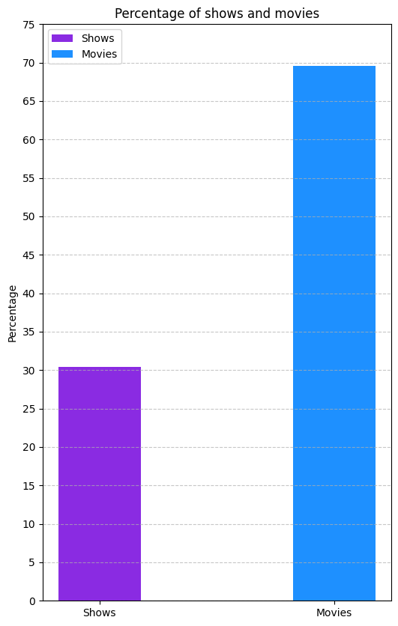
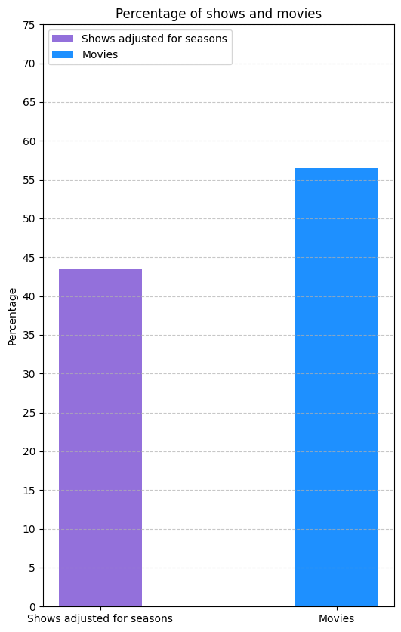
Movies vs TV shows:
Who sits on the iron throne of Netflix?
Are there more Movies than TV shows or vice versa?
Findings:
There are more Movies than TV shows but if you adjust for the multiple seasons some TV shows have, the results are much closer.
Movies 56%
Shows 44%

Slide 5
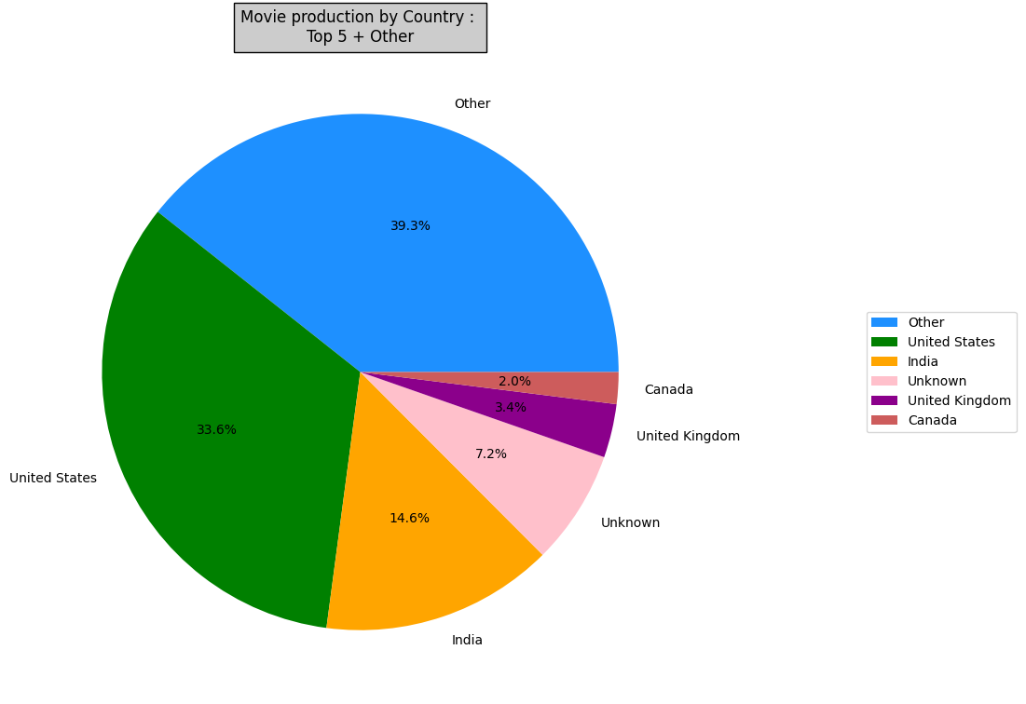
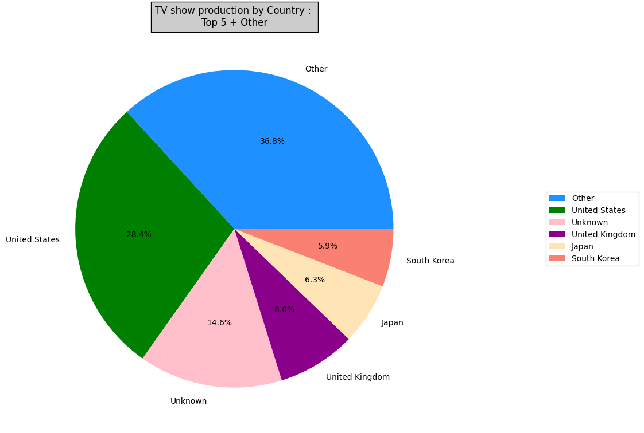
Nothing like ‘American Pie’!
Movies & TV shows by Country of origin
What Country produced the most films and Tv shows from what we know?
*Please note there were a high number of Unknown
Movies:
Focus on movies originating from United States, then United Kingdom as priority
TV Shows:
Focus on shows originating from United States, then United Kingdom, Then Japan and South Korea

Slide 6
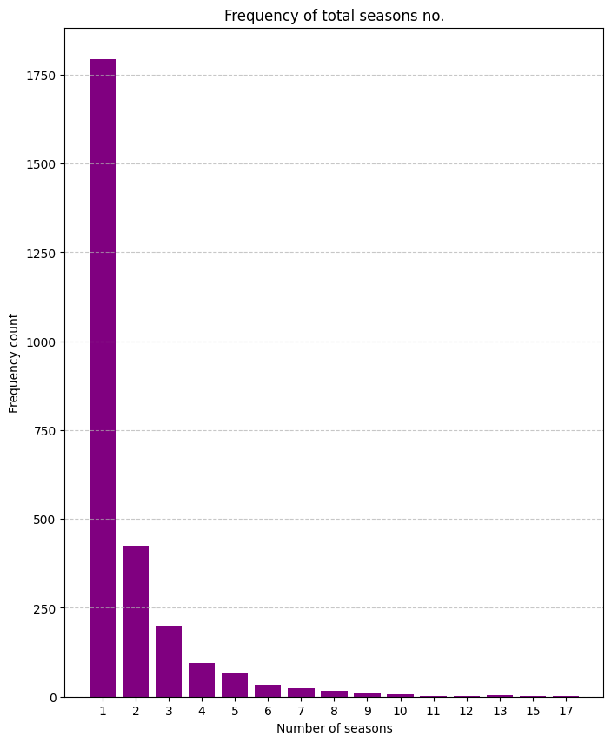
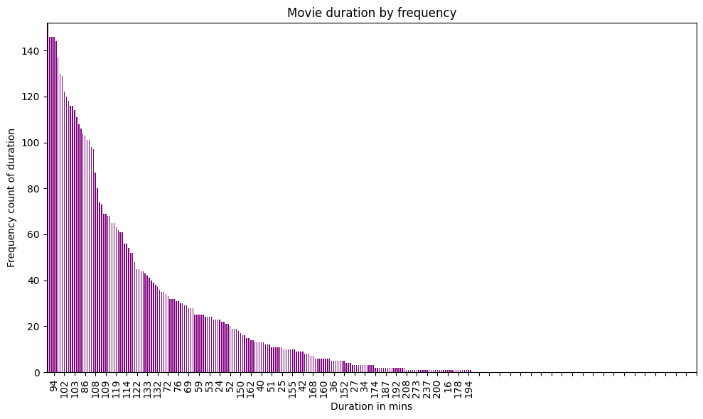

For TV Shows you can see the majority have only 1 season
Duration
How long do most movies last?
How many seasons do most TV shows run for?
For Movies you can see the majority have run for only 94 minutes. Infact the majority run from 94- 110 minutes
Greys Anatomy is the TV Show with the highest number of seasons – 17 (430 episodes)!
Black Mirror: Bandersnatch is the movie with longest duration – 312 minutes!

Slide 7
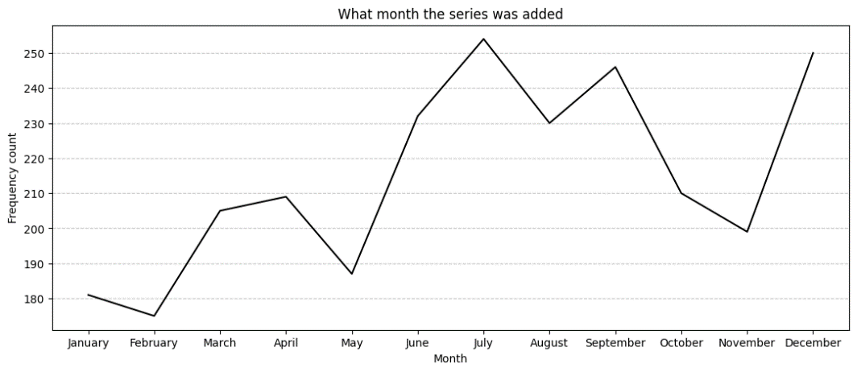
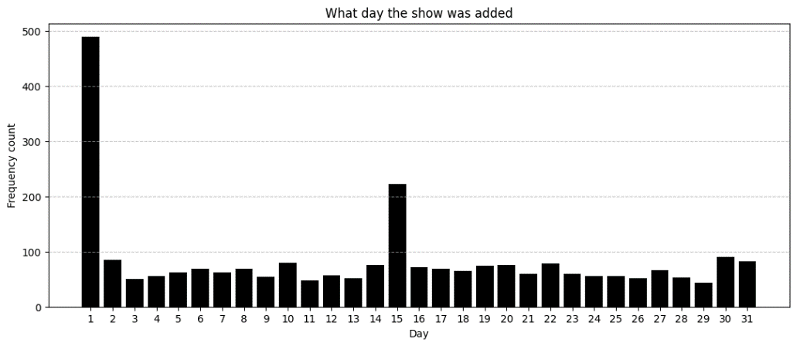

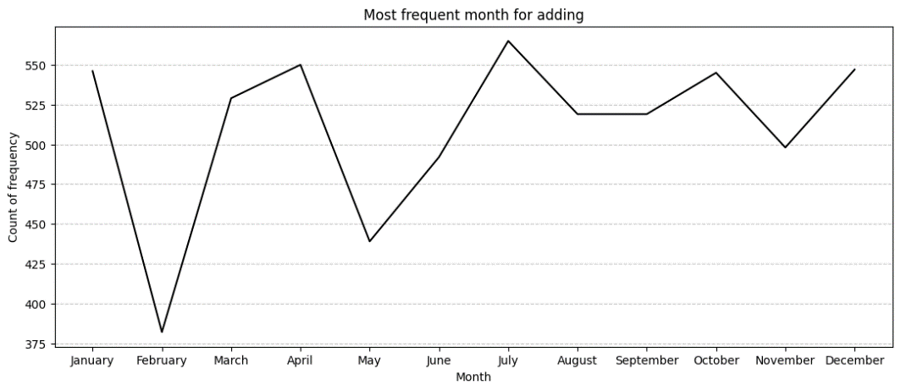

Date added
What day and month were most popular for adding items?
Findings
The 1st of the month was the day most movies and TV shows were added, with a small increase of additions on the 15th. There is a small steady adding of titles throughout the rest of the month.
Peak months for adding TV shows is July & November – most likely due to summer holidays from school and work and for the lead up to Christmas.
Peak months for adding movies is January, April, July, October & December – most likely due to Christmas / New Year, Easter, Summer holidays, Halloween.

Slide 8
Ratings descriptions
Children 2-13
TV-Y (All Children)
TV-Y7 (Directed to Older Children)
TV-Y7-FV (Directed to Older Children - Fantasy Violence)
TV-G (General Audience)
G (General Audiences)
TV-PG (Parental Guidance Suggested)
Adults and children older than 13.
PG (Parental Guidance Suggested)
TV-14 (Parents Strongly Cautioned)
PG-13 (Parents Strongly Cautioned)
TV-MA (Mature Audience Only)
R (Restricted)
NC-17 (Adults Only)
Not rated
NR (Not Rated)
Not Rated (Not Rated)
UR (Unrated)

Slide 9
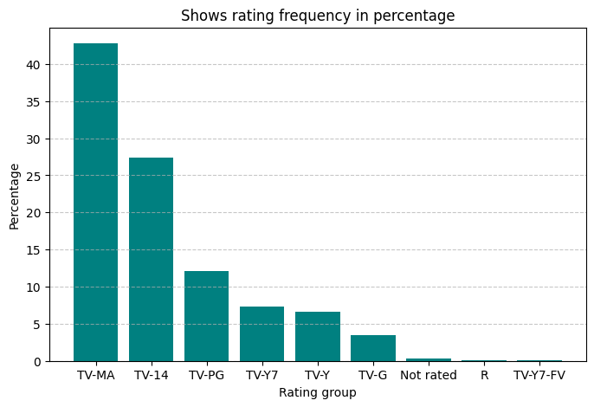
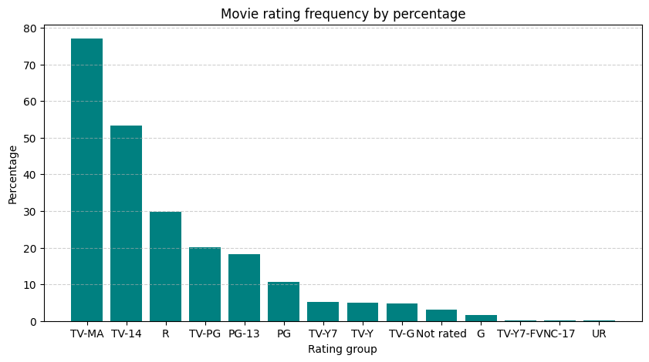
Ratings
What is the rating used most often for TV shows?
What is the rating used most often for movies?
TV Shows ratings
TV-MA 1145
TV-14 733
TV-PG 323
TV-Y7 195
TV-Y 176
TV-G 94
Not rated 7
R 2
TV-Y7-FV 1
Findings
Findings:
TV –MA was the most used rating for TV Shows and for Movies
This stands for ‘Mature Audiences Only’
Movies ratings
TV-MA 2062
TV-14 1427
R 797
TV-PG 540
PG-13 490
PG 287
TV-Y7 139
TV-Y 131
TV-G 126
Not rated 80
G 41
TV-Y7-FV 5
NC-17 3
UR 3

Slide 10
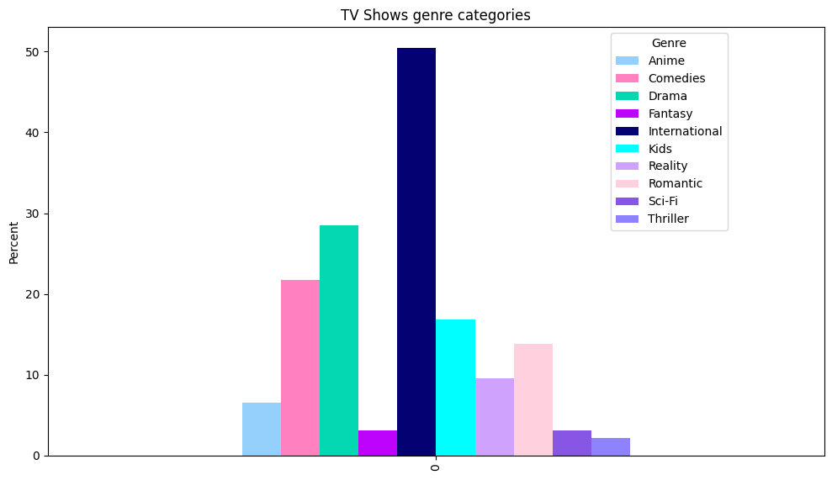
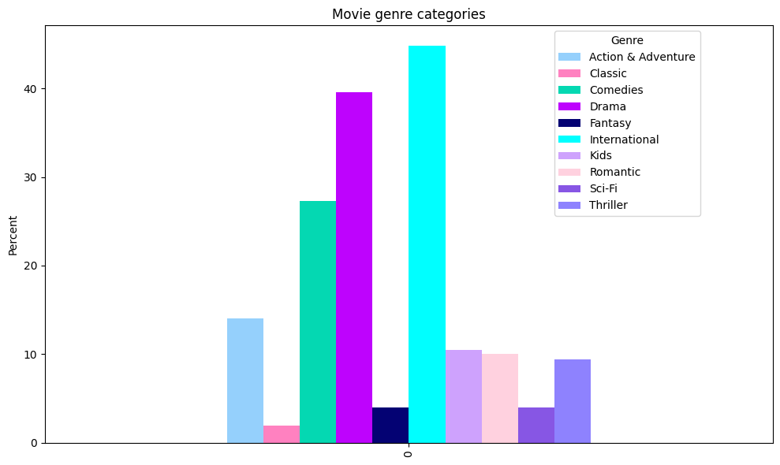
Genre
What is the most frequent genre type for movies & TV Shows?
Anime | Comedies | Drama | Fantasy | International | Kids | Reality | Romantic | Sci-Fi | Thriller
6.57 | 21.71 | 28.51 | 3.14 | 50.49 | 16.85 | 9.53 | 13.83 | 3.14 | 2.13
Findings:
For Tv shows –International is the largest category with more than 50%, followed by Drama at 28.5% and then Comedies at 21.7%
For Movies – International is largest at 44.9%, Drama is second at 39.6% and Comedies 3rd at 27.3%
For those ‘Hawkeye’s’ out there, you will notice that the categories’ percentages total over 100 for both movies and TV shows – this is because many overlap into different categories!
Action & Adventure | Classic | Comedies | Drama | Fantasy | International | Kids | Romantic | Sci-Fi | Thriller
14.01 | 1.89 | 27.3 | 39.58 | 3.96 | 44.89 | 10.46 | 10.05 | 3.96 | 9.41

Slide 11
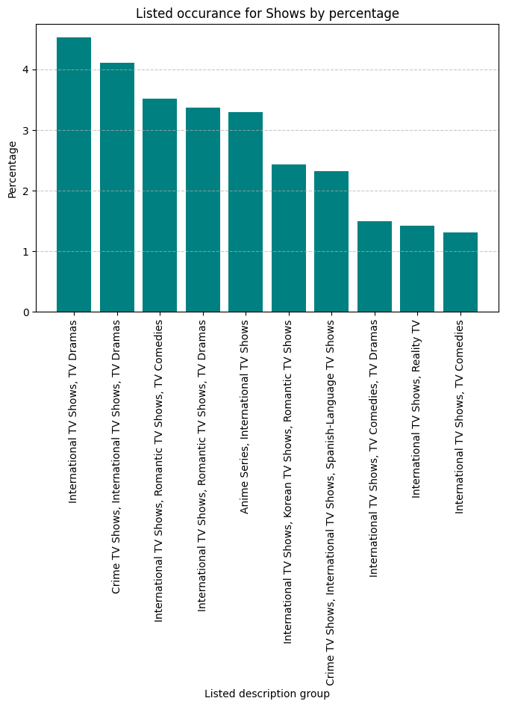
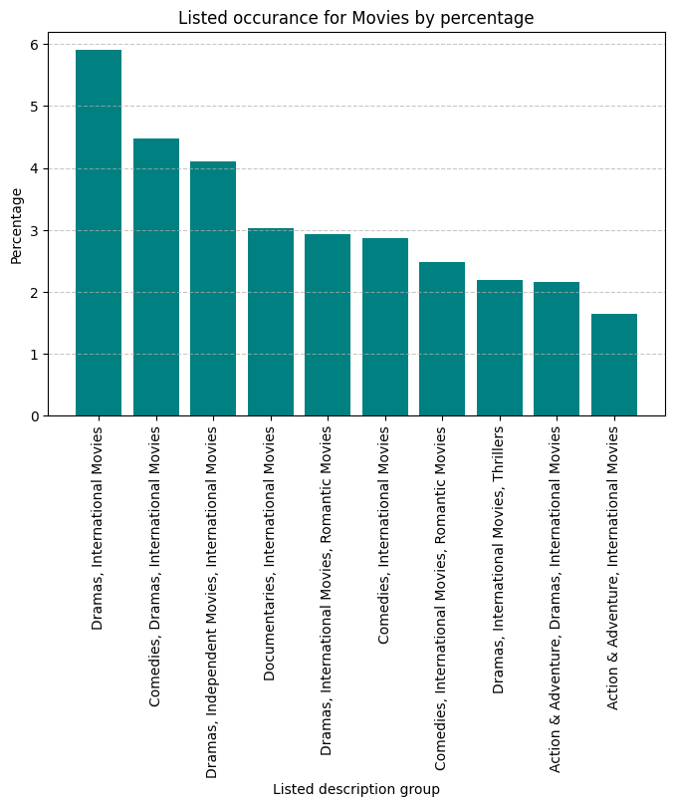

Genre:
International
INTERNATIONAL

Slide 12
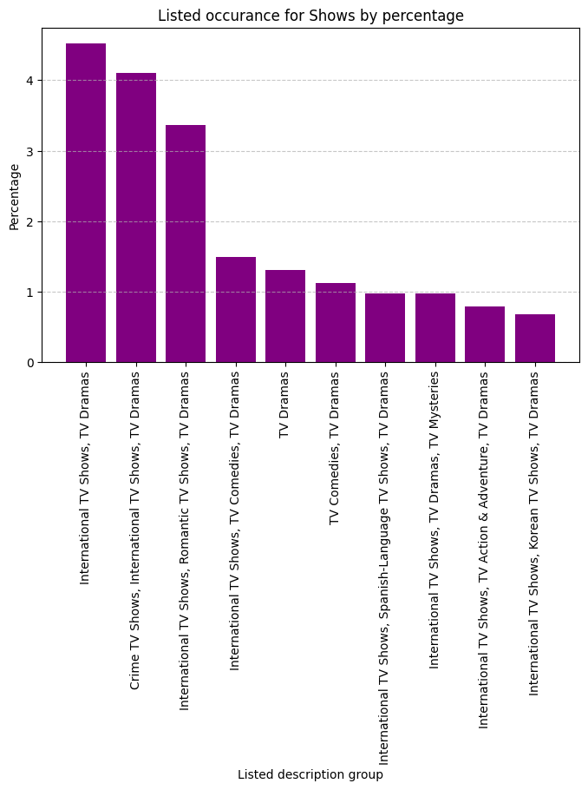
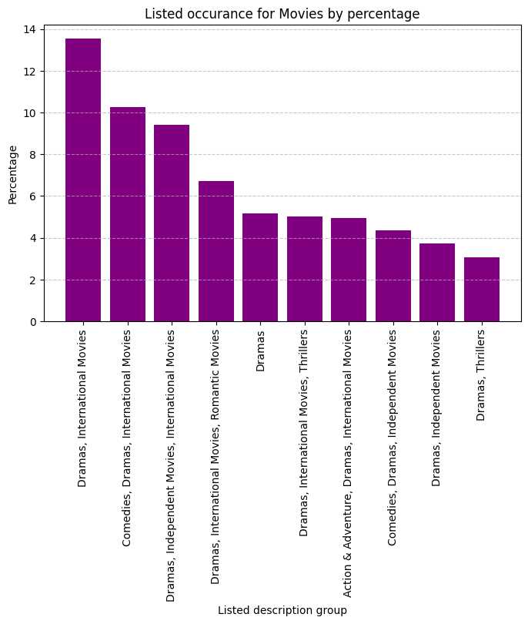
Genre:
Drama
DRAMA

Slide 13
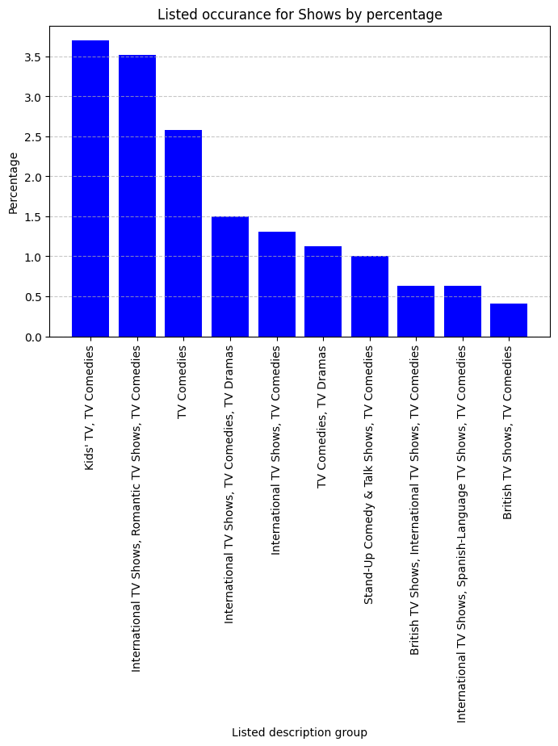
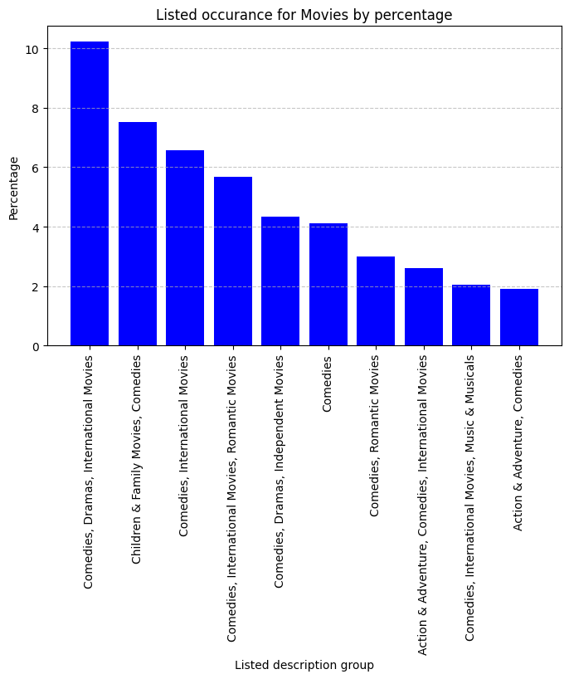
Genre:
Comedies
COMEDIES

Slide 14
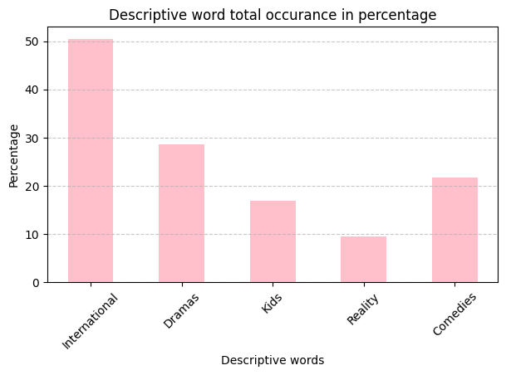

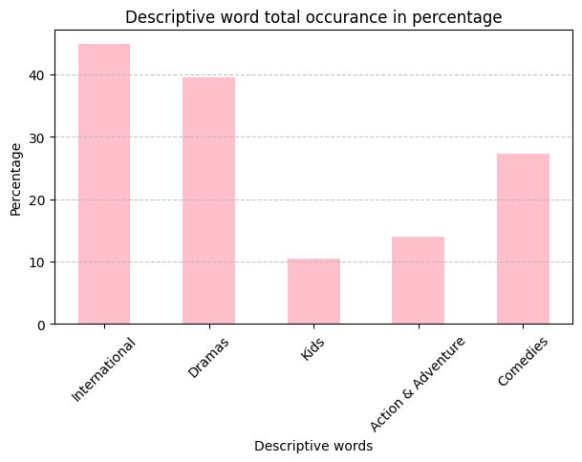

Genre:
Descriptive words used in genre type.
Which descriptive words were used most in the genre type, ie listed in column?
Findings
The Top 5 for Tv shows:
International
Drama
Comedies
Kids
Reality
TV SHOWS
MOVIES
Findings
The Top 5 for Movies:
International
Drama
Comedies
Action & Adventure
Kids

Slide 15
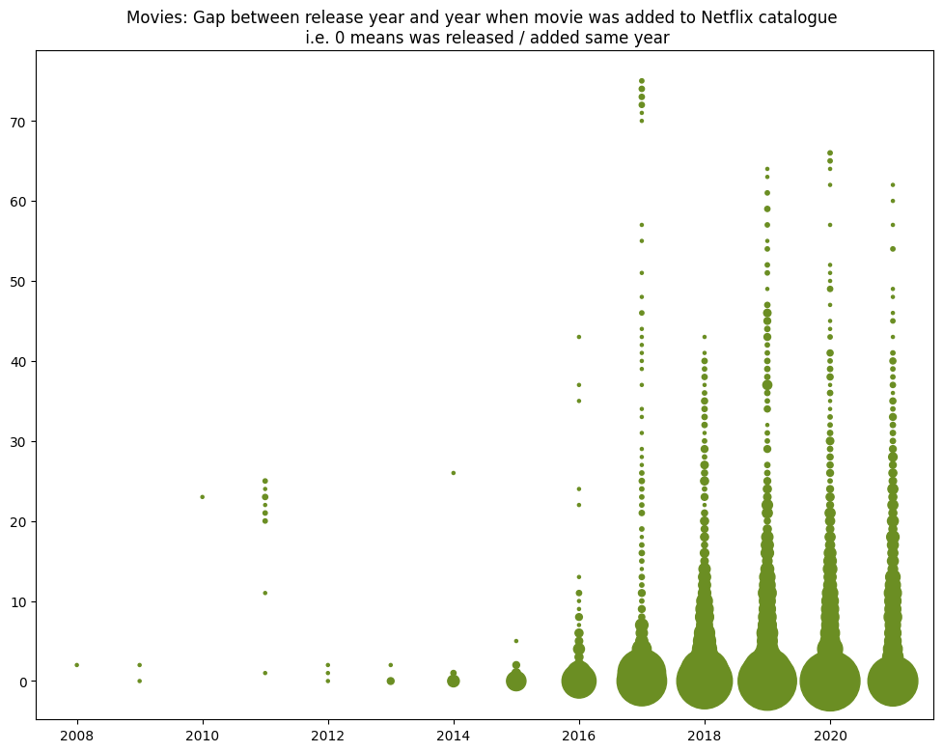
Movies:
Gap between the Year movie was released, and when Netflix added it to their catalogue
Findings
For the most part, the movies were added the same year as they were released but there are some, most likely, the classics that have been added over 70 years later!

Slide 16

Conclusions
Things to consider:
Collect data on user interactions to better understand the user and find the trends and where to focus.
It would be beneficial to have a breakdown of the ‘International’ category and what it encompasses.
There are more Movies than TV shows but if you adjust for the multiple seasons some TV shows have, the results are much closer.
Movies 56% Shows 44%
The 1st of the month was the day most movies and TV shows were added, with a small increase of additions on the 15th. There is a small steady adding of titles throughout the rest of the month.
Movies:
For replicating the success of Netflix:
Focus on movies originating from United States, then United Kingdom as priority
Films running from 94-110 minutes are most prevalent.
TV-MA was highest Ratings
Peak months for adding movies is January, April, July, October & December – most likely due to Christmas / New Year, Easter, Summer holidays, Halloween.
For Movies – International is largest category at 44.9%, Drama is second at 39.6% and Comedies 3rd at 27.3%
Top 5 movie genres:
International
Drama
Comedies
Action & Adventure
Kids
TV Shows:
For replicating the success of Netflix:
Focus on shows originating from United States, then United Kingdom, Then Japan and South Korea
1 season is more frequent than multiple seasons
TV-MA was highest Ratings
Peak months for adding TV shows is July & November – most likely due to summer holidays from school and work and for the lead up to Christmas.
For TV shows –International is the largest category with more than 50%, followed by Drama at 28.5% and then Comedies at 21.7%
Top5 TV Show genres:
International
Drama
Comedies
Kids
Reality
https://sites.google.com/view/kerryjackman/home
Anna link coming soon

Slide 17


